Slide 1

sales visualization and predictions
Shawn Michael
MSDS 696 Capstone 1i
Regis University

Slide 2
Agenda
Overview
Dataset
Data Cleaning
Exploration of the Data
Model Creation and Evaluation
Project Summary

Slide 3
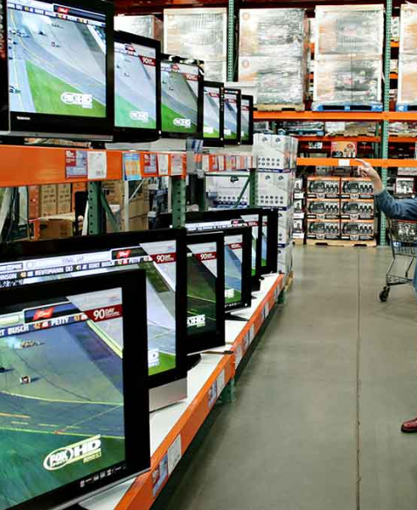
Overview
The purpose of the Black Friday data collection is to gain a deeper understanding of demographics pertaining to the customers they service versus the products offered by the business. The data analysis was done in R using a number of packages such as: tidyverse, broom and ranger.

Slide 4
Dataset
This dataset was a part of a competition host by Analytics Vidhya
The dataset for this project was extracted from
This dataset is accessed from Kaggle.com, at the following link: https://www.kaggle.com/mehdidag/black-friday
Black Friday Dataset contains 12 variables and 538,000 objects
2 separate files are attached because the processing is extensive One file has ~50,000 objects and the other contains the full observation count.

Slide 5
Data Cleaning
Reading the data into R using readr package, which helps with feature classification
Glimpse from tidyverse is a great tool to view the data easily and how each of the features were classified automatically.
A number of variables required modification, there were ~540,000 elements with missing data
Variables were defined manually and a strategy for NA developed

Slide 6
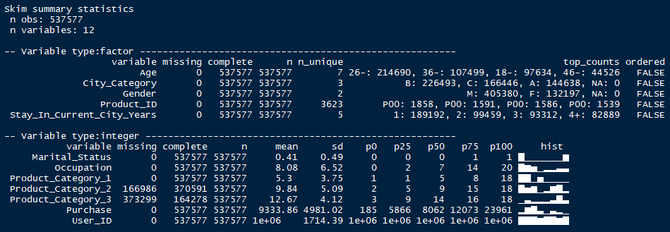
Data Exploration
First step is to get a sense of what type of data is available in the dataset
Skimr library
Objects and variables
Data is grouped by variable type
Variable name, missing or not, count of objects
Statics seen with summary(), plus a histogram

Slide 7
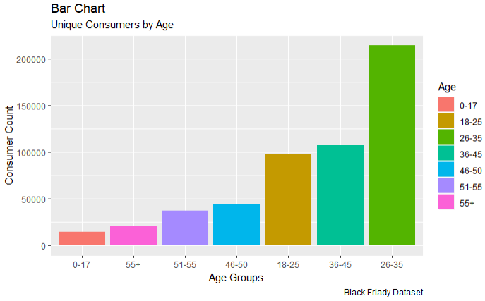
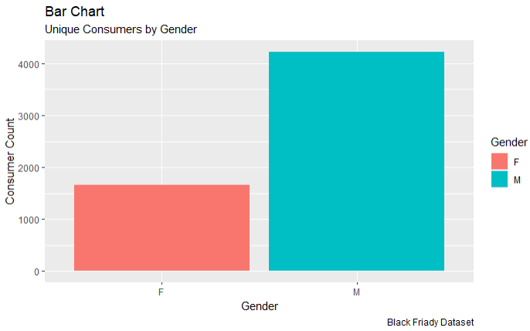
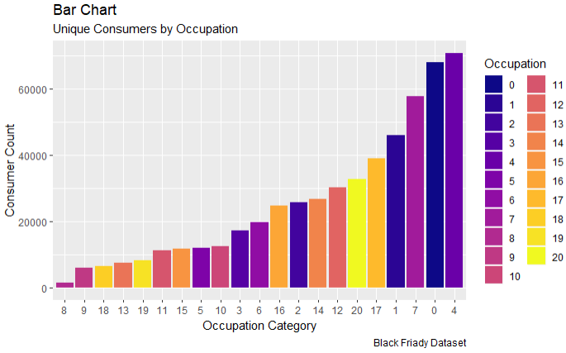
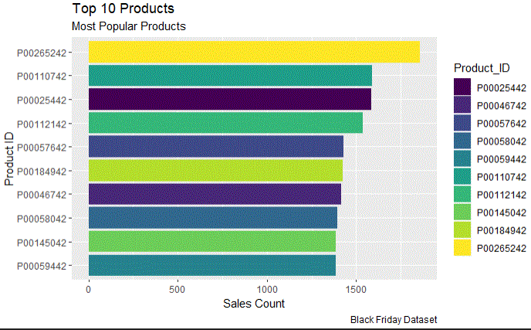
Black Friday Basic Data Visualization

Slide 8
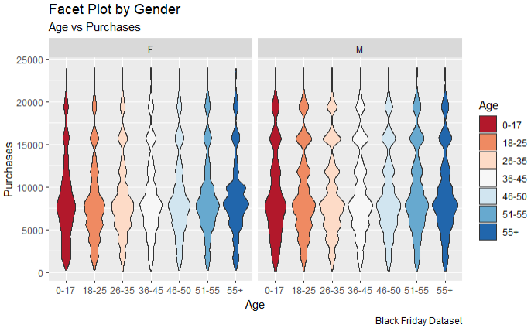
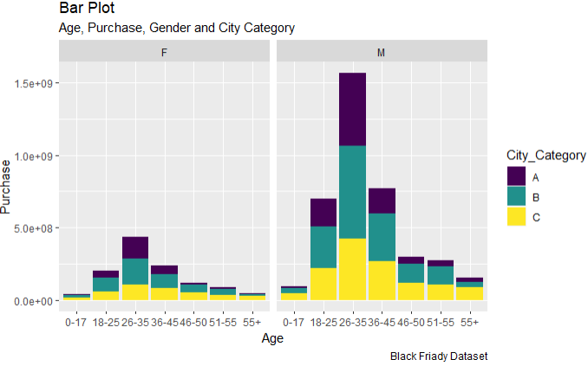

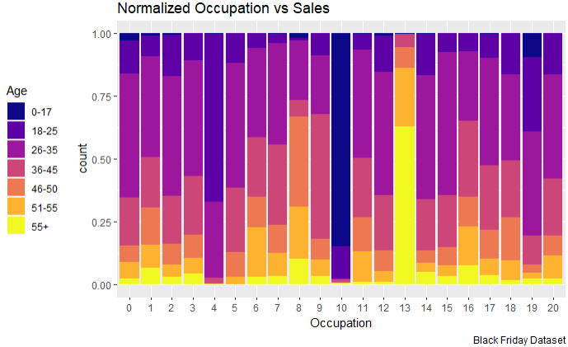
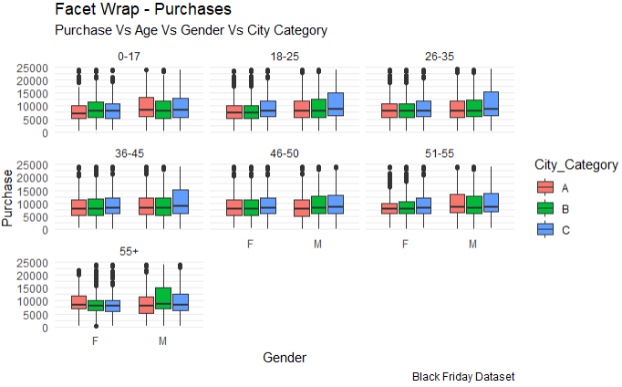
Multi-dimensional Visualizations

Slide 9
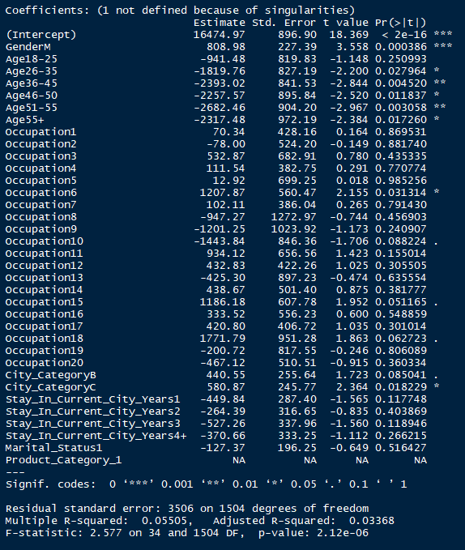
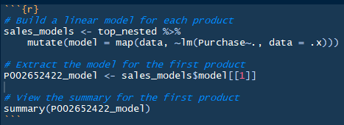
Linear Modeling: Top 5 products

Slide 10
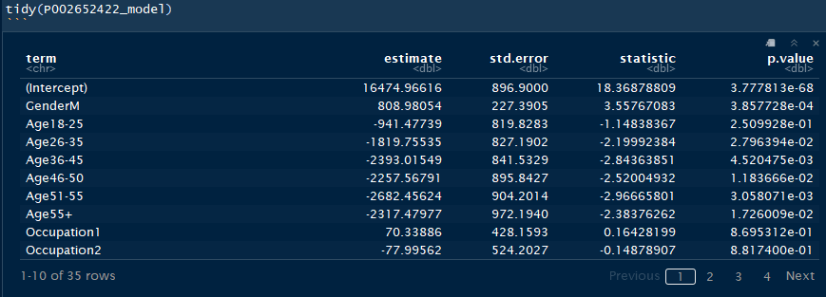
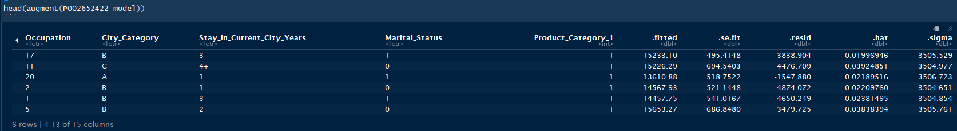
Linear Models Top 5 Continued

Slide 11
Create Linear Regression Models for every Observation
Validate
TRAIN
Models
3541.54
3684.84
3452.21
Mean Absolute Error

Slide 12
Partition Data for model creation
TRAIN
TEST
Separate Data into Train / Test
TRAIN
Validate
TEST
Create a Train / Validate Split
TRAIN
Validate
TRAIN
Validate
TRAIN
TEST
Create Cross Validation Folds
Validate
TRAIN

Slide 13
Models used for ~540,000 separate predictions
Linear Regression
Random Forest
Notes:
Every train portion was used to build a model, while the validation portion of the train dataset was used in validation.
This affords the ability to measure the validation performance on each of the cross-validation folds, for each model, and associated hyperparameter.
Combining the validation performance for each model, allowed me to compare multiple models, as well as their individual hyperparameters.
This provided insight to identify the model-hyperparameter combination, with the best overall performance.

Slide 14
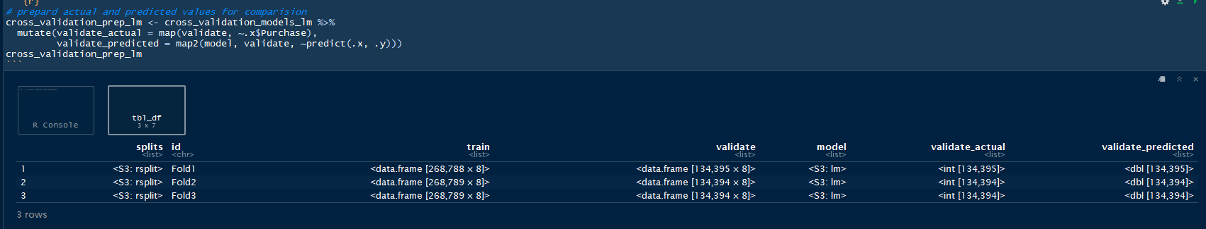
Example of cross validation models
MAE = 3622 LM

Slide 15
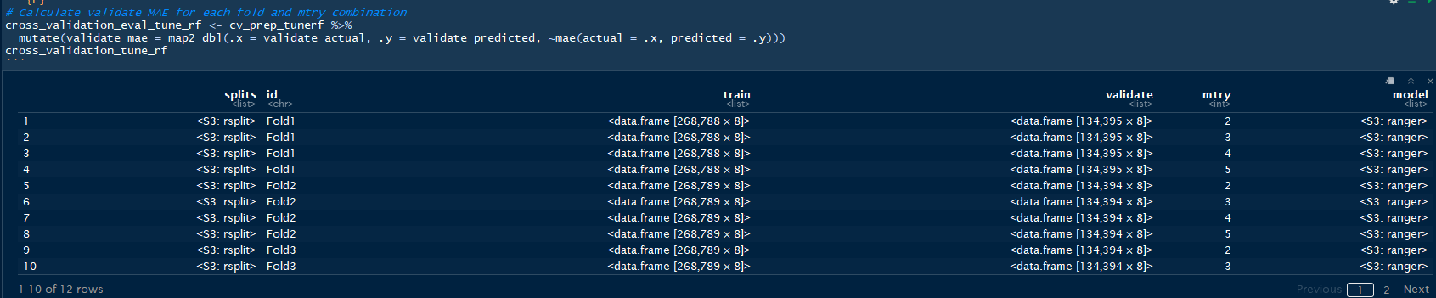
Random Forest
First Pass for the Random Forest
MAE = 2525.96
Tuning for the second pass included the mtry hyper-parameter
MTRY = 4 yielded lowest MAE

Slide 16
Summary
Linear Regression
DT Regression 1st pass
Mean Absolute Err: 3622.306
RF Performance 1st pass
Mean Absolute Error: 2525
RF Performance 2nd pass
Ran test data through my model
Mean Absolute Err: 2186.14

Slide 17

Thank You
Regis University

